Slide 1
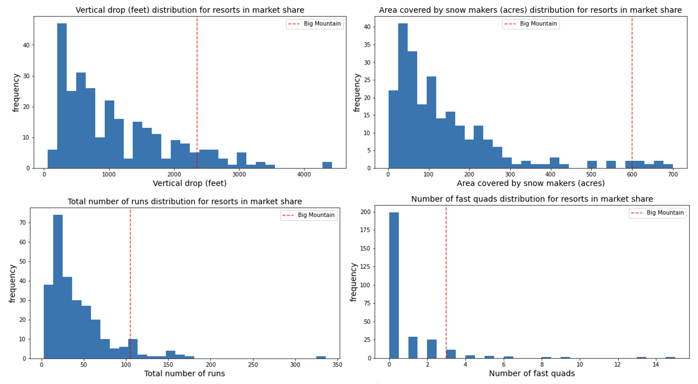
Big Mountain Resort – Problem Identification (1)
While the resort compares favorably with others in the US in natural beauty and physical facilities…

Slide 2
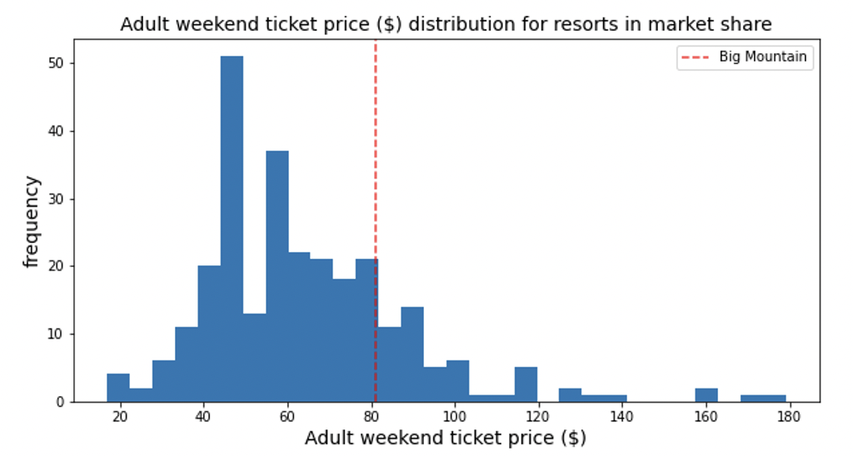
Big Mountain Resort – Problem Identification (2)
…there has not been a systematic investigation into pricing support for a higher ticket price or scenario analysis.
This analysis does that.

Slide 3
Big Mountain Resort – Applications and Recommendation
Application 1: Support for Higher Weekend Prices
Our analysis indicates Weekend Adult price could support $95.77 ($10.39 average error on each side) vs the current price of $81.00
Application 2: Scenario Analysis
A scenario where a 150ft increase of vertical drop via a new run and a new chair could support an increase of $1.99 of Adult Weekend price. With 350,000 visitors at 5 visits per year, this corresponds to an increase of $3.47M in revenue.
Compare the increase to the $1.54M operating cost of a new chair.
Recommendation
We recommend that other teams in the company take a closer look at the model and the results and see how we could make use of it

Slide 4
Big Mountain Resort – Data and Model (1)
Data (A merge of Resort Data and State Data)
Resort Data: Data from 330 resorts across the US with features that combine state, region, resort natural characteristics (summit elevation, vertical drop, area, etc), resort facility characteristics (runs, quads, chairs, snow making, night skiing, etc) and price (Adult Weekend & Weekday).
State Data: Population and area data for states.
Combined Data: A merged dataset consisting of various state measures (state resorts per capita / per 100sq miles) and resort shares in state (% resort skiable area in state resort total, etc…) Total remaining resort in dataset: 277: 49 missing both Adult Weekend/Weekday prices, 4 more missing only Adult Weekend; an analysis of composition of missing data was not made)

Slide 5
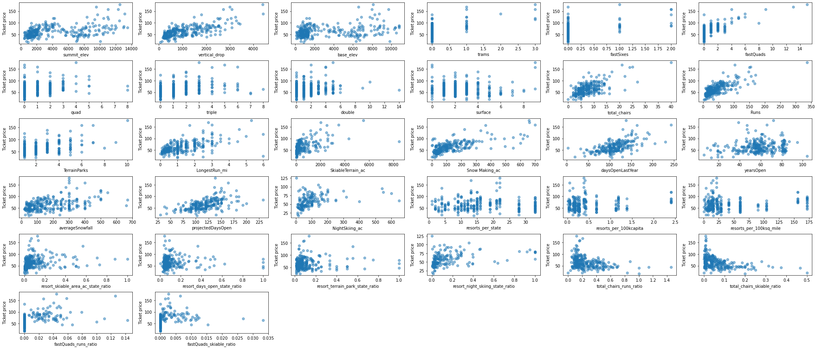
Big Mountain Resort – Data and Model (2)
Data (Features vs Adult Weekend Price)

Slide 6
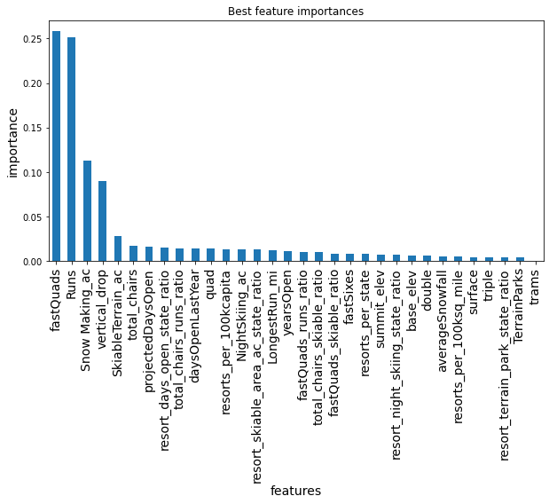
Big Mountain Resort – Data and Model (3)
Model
A set of random forest regressor models and linear regression models were trained on the target feature.
A random forest model was chosen based on its smaller mean absolute error and lower standard deviation.
Feature importances of the final model are shown to the right with Fast Quads, Runs, Snow Making and Vertical Drop being the most important
The model is used for both pricing and scenario analysis.

Slide 7
Big Mountain Resort – Summary and Conclusion
We believe the company can benefit from this analysis where we identify pricing support for a higher ticket price and present a scenario analysis tool.
The model will be available on a web server for general use, with regular data updates and model calibrations.

